Slide 1
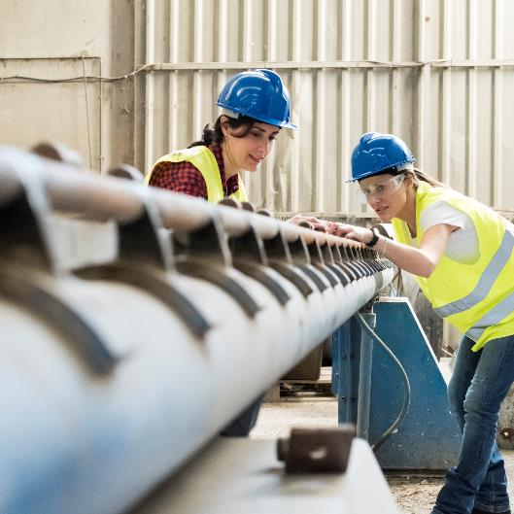
Auto-enrolment – all you need to know.
Add Broker Logo here
Information for Employers
Spring 2025

Slide 2
Auto-enrolment has been discussed for decades
Introduction is imminent
2007
Seamus Brennan, Minister for Social Welfare publishes first white paper on AE in 2007
2011
Joan Burton, Minister of Social welfare publishes green paper with draft design – implementation in 2014
2018
AE strawman published – 2022 launch date planned
Late 2025
Launch date for ‘My Future Fund’ – the AE scheme in Ireland

Slide 3

Why does Ireland need auto-enrolment?
Today, there are approximately 800,000 people without a private pension
  Ireland has an ageing population
  Too many relying solely on the state pension
  Will lead to retirement poverty for many
  Inertia prevents people from saving for retirement

Slide 4

Who will be auto-enrolled?
An estimated 800,000 workers who:
Earn over €20,000 per year
Are aged between 23 & 60
Are not already in a pension scheme
Includes employees on probation, casual, seasonal or part-time contracts
Voluntary opt-in for employees outside age and income thresholds
Those currently excluded:
Self-employed
Non-earning
Active members of Occupational schemes, PRSAs and PP's (ER or EE Payroll deducted)
Notes:
The eight hundred thousand or so who are eligible for My Future Fund are employees who meet this criteria.
They will need to be aged between 23 and 60 to be automatically enrolled, but any employee younger or older than this will be able to opt-in if they want.
The earnings threshold will be a gross salary of €20,000, but those who earn less than this will be able to opt-in. Gross earnings across all employments will be used to determine eligibility, and I’ll explain this more on the next slide.
The last criterion is that the person isn’t already in a pension scheme. Any pension contribution from an employer or an employee, paid through the payroll, will deem the person ineligible for that employment.
The reason for this is that auto-enrolment is being set up for people who don’t already have a pension, not to replace the existing pensions industry.
All employees who meet these criteria will be enrolled, regardless of their contract type, so whether they’re on probation or working part-time for example.
Other cohorts like the self-employed and those who aren’t currently working for an employer won’t be enrolled, and won’t be able to opt-in initially.

Slide 5

There is an opt-out facility for employees
Opt-out facility
Employees who are included must remain in the scheme for the first 6 months after which they can opt out in months 7 or 8 if they so wish.
Employees will also be able to opt out after each contribution rate increase.
Employees will also be able to pause or suspend their contributions at any stage after the first 6 months of the scheme.
In all cases where an employee opts out or pauses/ suspends contributions they will be automatically enrolled back into the scheme after two years.

Slide 6
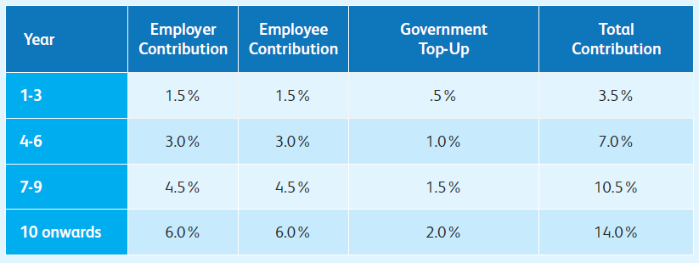
Contribution Rates – rising over 10 years
Employee, Employer, and the State
Contributions include employee and employer contribution, with a government top-up equal to 1/3rd of the employee contribution.
Contributions increase every 3 years over the first 10 years of the scheme
Salary ceiling of €80,000p.a.

Slide 7

Retiring and Investing
Employees
Retirement benefits - employee “draw-down” will also be linked to the State pension age (this is currently age 66).
Members will be able to draw-down their funds as a lump sum, annuity or other approved retirement products in line with pension and taxation law prevailing at the time of retirement
Remains an ongoing examination of post-retirement options – perhaps some future detail/change
Investing - employees/members will be free to choose from a small range of risk / return funds but will be automatically enrolled in a default lifestyling fund.

Slide 8

Other key features
Employees
Member account portability between employments will be facilitated by a ‘pot-follows-member’ approach.
No AVC facility at initial stage – this means employees cannot make additional payments into the AE system
No self-employed at initial stage – it has failed in other jurisdictions

Slide 9



Communication – awaiting clarity from the Government
3-phase strategy
Awareness – still low Benefits – what it will do for people Launch |  | Market Research, Stakeholder Engagements, Possible Advocates |  | All media types– geared towards all audiences

Slide 10


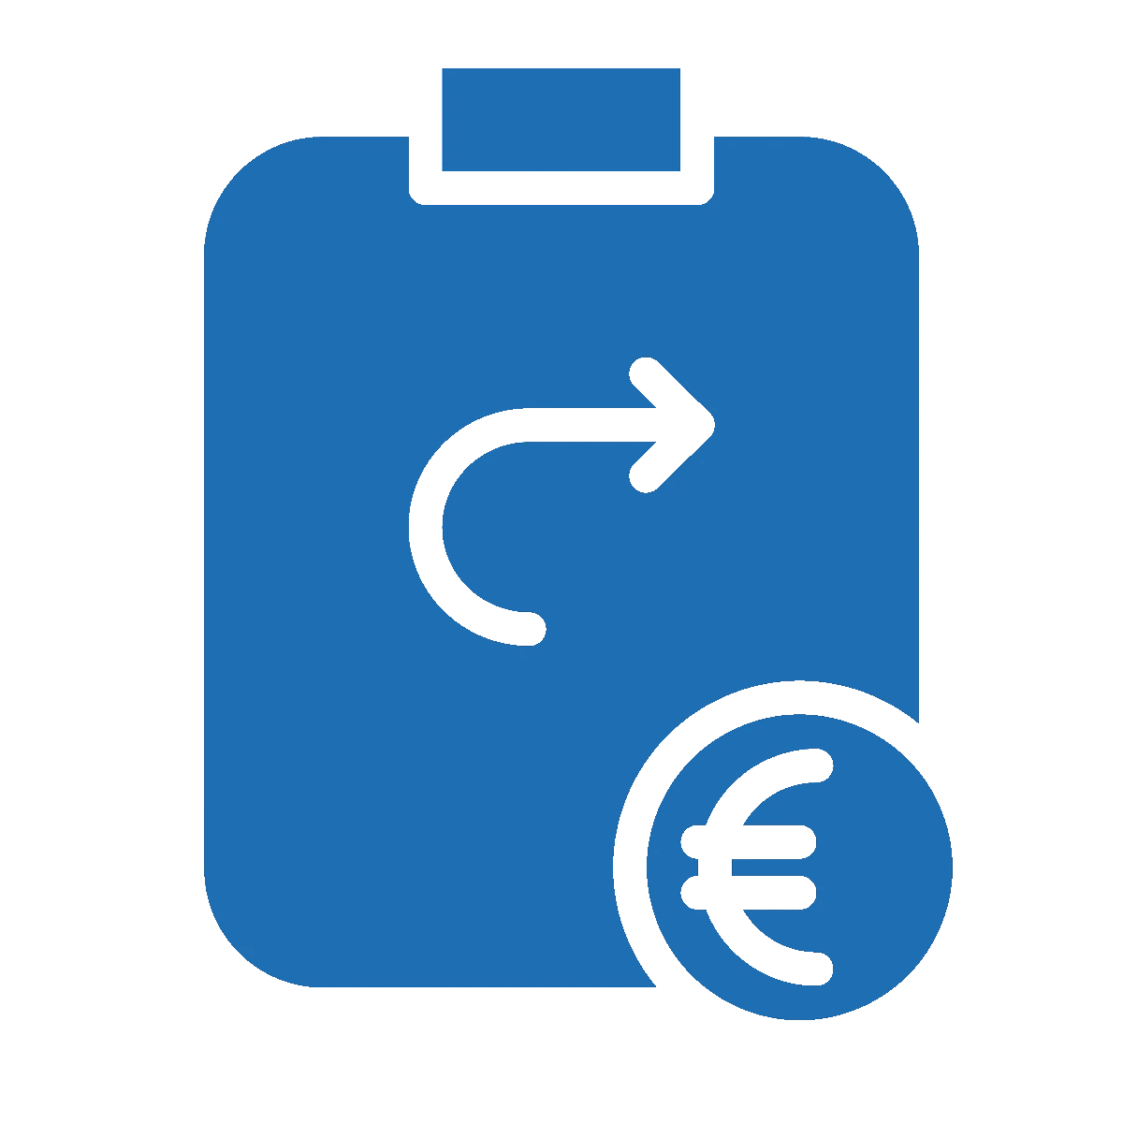
Auto-enrolment
What is still happening
Regulation being drafted | Procurement ongoing | Costings and Financing
Passed by the Oireachtas | Procurement ongoing | Enforcement date

Slide 11
Immediate actions for Employers
Preparation is important

Slide 12
Who will run My Future Fund?
The National Auto Enrolment Retirement
Savings Authority (NAERSA) will
Collect Contributions
Allocate Investment returns
Operate online portal for employers and employees
Offer Back Office support
Communicate and Provide Information
Notes:
In addition to opt-out, employees can also decide to suspend or pause their contributions.
This option will be available after the first six months of being enrolled. This is give people time to adjust to the scheme before they decide to suspend contributions.
Employees will be able to suspend their contributions for a minimum of one year, up to a maximum of two years. Employer and State contributions will also be paused during this time.
Employees won’t receive a refund of their contributions, as they’ll just be taking a break from paying them.

Slide 13

4 points on AE to note for Employers
Registration on Employer Portal required
1.
Payroll Software updates needed before AE goes live
3.
Income from multiple employments is considered for auto-enrolment
2.
Staff must be informed of AE Membership
4.
Notes:
Before we finish up, I want to reiterate and highlight these four points that employers might need to consider.
Later in the year, ahead of the launch of My Future Fund, we’ll be asking employers to register their details on an online portal, and to set up a variable direct debit. This is to ensure that when the scheme launches, that there is no delay in the transfer of contributions from employers to NAERSA. By registering when the facility opens, employers can make sure that they are compliant with their auto-enrolment obligations and don’t run the risk of incurring fines or penalties.
There won’t be any standards for existing pension schemes to meet when automatic enrolment is first introduced. Once there is a pension contribution from an employee or employer through the payroll, the employee won’t be enrolled in AE.
However in the future, when AE contribution rates increase, standards will be developed in conjunction with the Pensions Authority. This will be to ensure that other pension schemes are at least as favourable as My Future Fund.
There won’t be a waiting period for auto-enrolment in the same way that waiting periods exist in other schemes. However, there could be a period of time before an employee is enrolled so that it can be determined if they will meet the €20,000 threshold. This will especially be the case for new employees with no earnings record with Revenue.
It’s important to remember that if an employee has multiple employments, the income from all of those employments will be assessed for the income threshold.
It’s also important to note that the earnings threshold of €20,000 is an enrolment trigger. Once an employee reaches this threshold they are enrolled, and they will stay enrolled, even if their income goes below €20,000 a year at any stage.

Slide 14

What will employers have to do?
Payroll will be the “interface” for AE
1
Contributions to the NAERSA will be via payroll deduction.
2
Employers will match the member’s contributions up to an eventual maximum of 6% (initially limited to 1.5% of the member’s earnings to a ceiling of €80,000, increasing at 1.5% every three years to a maximum of 6% from year 10).
3
Employer contributions will continue to be deductible for corporation tax purposes.

Slide 15
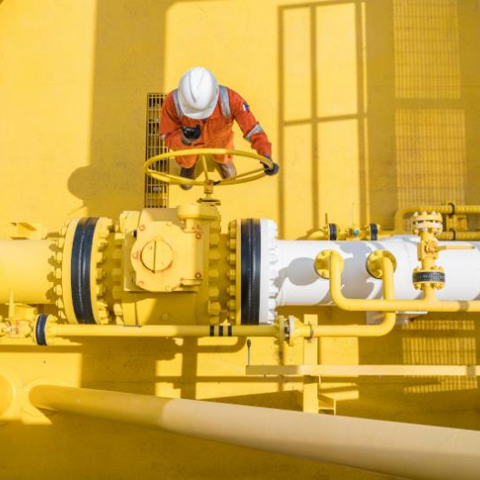
What about your existing pension scheme?
Potential Challenges
Anyone not in a scheme will be auto-enrolled
Voluntary
Vesting Periods
Probationary Periods
Standards and Exemptions
  Exempt all in a salary deduction scheme initially
  Over time standards will be set (2031)
“Best Pot Wins”
Hybrid v Integration

Slide 16

Considerations for employers – where do you need to do?
Act now
1
Eligibility - check eligibility periods – keep same or alter with provider
2
Higher rate taxpayers – need to find the best home for them!
3
New joiners – potential new category for membership of existing scheme and change of contract if appropriate
4
Education - educate non-members of existing schemes as to what suits them best

Slide 17
Thank you
Questions?
Add Broker Logo here
Zurich Life Assurance plc is regulated by the Central Bank of Ireland
Inset Financial Broker is regulated by the Central Bank of Ireland.
Warning: Past performance is not a reliable guide to future performance.
Warning: Benefits may be affected by changes in currency exchange rates.
Warning: The value of your investment may go down as well as up.
Warning: If you invest in this product you may lose some or all of the money you invest.

